Slide 1
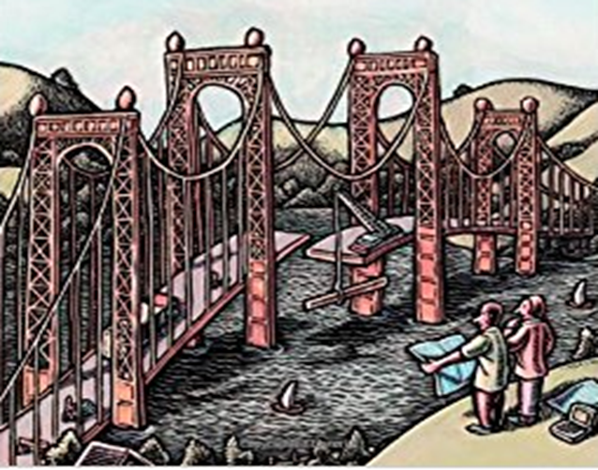
Behavioral Models
(State Diagram)

Slide 2
Recap
We discussed on defining the context of system using both static and dynamic components.
The static components we looked the blocks of functionality which we wanted to implement, identified the objects derived the classes at the grass-root level, understood how to represent/abstract them into objects/classes factoring in their attributes, responsibilities and operations which it would need to support and the relationships between these classes as part of a class diagram.
We then modelled these into a hierarchy of components (like modules and submodules) using the Component diagram, we discussed the individual components and how they could be modelled (represented along with their interfaces).
We then discussed on how these components can be related physically by associating each of the components with physical nodes where these components deployable as packages with respective artifacts, would be hosted for execution as part of Deployment diagrams.

Slide 3
Recap
We then discussed on we could bring in the interactions between the classes/objects and components into a set of dynamic or behavioral models.
There were two basic models which we discussed for bringing in the dynamic behavior or interactions of the classes to produce useful results.
Activity Model
We modelled and represented the workflow of the as activities made up of atomic actions sequentially and concurrently factoring in essential dependencies. We used concepts of swimlanes to partition to group them together.
Sequence Models
We modelled and represented sequence of events that would occur during a particular a usecase’s execution. This would include all the communication in terms of messages which are exchanged between the objects participating in the execution of an action (which is part of an activity)

Slide 4
Generics of State Diagram
We now discuss the dynamic behavior of objects over time by modelling the lifecycles of objects of each class over the objects life span represented as the state diagram
In the state diagram we consider
Each object treated as an isolated entity that communicates with the rest of the world by detecting events and responding to them.
Events representing the different changes that objects can detect... anything that can affect an object can be characterized as an event
The state of an object is a condition or a situation during the life of an object during which it satisfies some condition, performs some activity or waits for an event
When an event occurs some activity will take place based on the current state of the object
Activity which is an ongoing non atomic execution within the state machine, results in some action which could be made of some atomic computation that results in the change in the state of the model or a return of a value

Slide 5
State Diagram
State diagram can be visualized as representation of potential states of the objects and the transitions among the those states
Few points which are inherently true for these would be
An object must be in some specific state at any given time during its lifecycle.
An object transitions from one state to another as a result of some event that affects it.
There can be only one start state in a state diagram, but there may be many intermediate and final states
We take the approach of looking at the different terms and concepts which are part of this and look at state diagrams

Slide 6
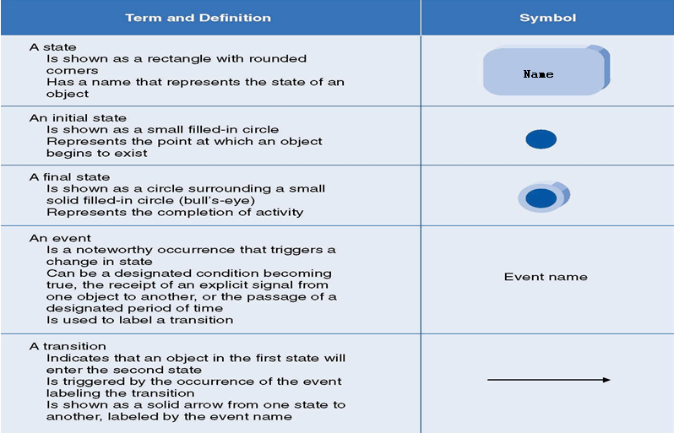
State Diagram UML Symbols

Slide 7
State Diagram Terms and Concepts : Events
Object instance could be exposed to different events like
An Event is an occurrence at a given point in time. It often corresponds to a verb in past sense or on the onset of a condition other E.g. User depresses a button, customer reports a problem, shipment arrives, phone taken off hook, paper try becomes empty, temperature falls below zero
A event represents a named object that is dispatched (thrown) asynchronously by one object and then received (caught) by another
Located in time and space, considered as Instantaneous occurrence, Duration unimportant – the fact that it has occurred is important
These events could be
Normal as well as error conditions
External or internal (e.g. page loaded)
Concurrent and Related Events
Related events if one event logically or causally follows another
If the events are causally unrelated they are concurrent events
Signal
Passing of time
Invocation of an operation (call)
Object
Change in some condition
Creation or destruction of a object

Slide 8
State Diagram Terms and Concepts : Events types – Signal Event
Signal – One way transmission of information/message from one object to another
An object sending a signal to another object may expect a reply, but the reply is a separate signal under the control of the second object, which may or may not choose to send it.
Signal Event is the event of sending or receiving a signal
Contrasting signal and signal event, signal is a message between objects, whereas the signal event is an occurrence in time

Slide 9
State Diagram Terms and Concepts : Events types – Signal
Signal occurrences are unique, but are grouped to signal classes with a class name to indicate common structure and behavior. They also have attributes indicating values they convey
They are represented in UML as <<signal>> on top of class name
«signal»
MouseButtonDown
button
location

Slide 10
State Diagram Terms and Concepts : Events types – Call Event
Results in a dispatch of an operation (contrast to signal which represents the occurrence of a signal)
Receipt by an object of a request for an operation
Operation may change state of receiver
Call event handled by operation (method)
Generally synchronous
Control transfer to receiver, Caller blocked till operation completed
event
Book Available
issue (User)
Book Issued
Parameter

Slide 11
State Diagram Terms and Concepts : Events types – Change Event
Caused by satisfaction of Boolean expression
Modeled using
when (expression)
Expression below is continuously (practically) tested & whenever the expression evaluates to true the event happens
Examples
when (inventory < reorder point)
when (storage used > maximum allowable)
when (altitude < 10000)
when (room temperature < heating set point )
when (room temperature > cooling set point )
when (battery power < lower limit )
when (tire pressure < minimum pressure )
Generally detected by polling or other application logic
when (11:49PM)/selfTest()
idle
Change event

Slide 12
State Diagram Terms and Concepts : Events types – Time Event
Represents elapse of time or absolute time
Modeled using
when (expression)
after (expression)
UML notation for an absolute time is the keyword when followed by a parenthesized expression involving time.
Eg: -- when (date = November 1, 2011) -- after (10 seconds)
when (11:49PM)/selfTest()
idle
Change event
time event
After(2 seconds)/ dropconnection()

Slide 13
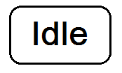

State Diagram Terms and Concepts : State
State is an abstraction of values and links of an object (some internal condition). Sets of values and links are grouped together into a state according to the gross behaviour of objects.
States correspond to verbs with a suffix of “ing” (Waiting, Dialing) or the duration of some condition (Powered, BelowFreezing)
Objects of a class have a finite number of possible states. Each object can be in one state at a time.
State determines response of the object to input events. All inputs other than ones which are defined for are ignored
State of the object depends on the past events which in most cases are eventually hidden by subsequent events
Events corresponds to a specific points in time and states represent intervals of time between two events received by the object
State is represented as

Slide 14
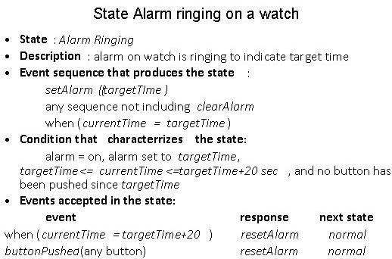
State Diagram Terms and Concepts : Characterizing States

Slide 15
State Diagram Terms and Concepts : Characterizing States
States of a Taxi Object for Example
Name
Description
Entry/Exit effects
Actions executed on entering and exiting the state
Events accepted, not accepted, deferred for a state
Apply it to the example states here
Sub-states
Apply it to the example states here
States of a taxi object
Available
InService
OutOfOrder
UnderRepair

Slide 16
State Diagram Terms and Concepts : Transition and Conditions
Transition: an instantaneous change in state from one state to another
triggered by an event
Transition is said to fire upon the change from source to target state
Original and target state of a transition depends on the original state and could be different or the same.
e.g. when a phone line is answered, the phone line transitions from the Ringing state to the Connected state.
Guard Condition:
boolean expression that must be true for transition to occur
checked only once, at the time event occurs; transition fires if true
e.g. when you go out in the morning (event), if the temperature is below freezing (condition), then put on your gloves (next state).
Guard Condition Example – Turnstile with coin

Slide 17
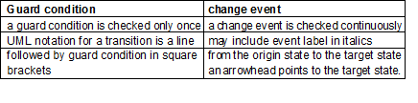
State Diagram : Guard Condition vs Change Event

Slide 18
State Diagram :
State Diagrams show the sequences of states an object goes through during its life cycle in response to stimuli, together with its responses and actions;
A state diagram is a graph whose nodes are states and whose directed arcs are transitions between states.
It represents
State sequences caused by event sequences
State names must be unique within the scope of a state diagram
Common behavior of all instances of the class

Slide 19
State Model :
A state model consists of multiple state diagrams one state diagram for each class with important temporal behavior. The individual state diagrams interact by passing events and through the side effects of guard conditions.
UML notation for a state diagram is a rectangle with its name in small pentagonal tag in the upper left corner. The constituent states and transitions lie within the rectangle.
States do not totally define all values of an object.

Slide 20
State Diagram :
Event: Signal event shown as a label on a transition and may be followed by parenthesized attributes. Change event - when (Boolean expr) Time event – when (time) or after (time duration)
State
Solid box .. Could have start state circle and final state bulls eye
State diagram with the diagram name in the left upper corner
State diagram Name
Guard condition
State 1
do/activity
event/effect
State 2
do/activity
event/effect
event (attributes) [condition]/effect
Transition
Drawn as a line from the original state to the end state. Arrow head points to the target state.
Effect: Behaviour in response to an event
Event can be entry, exit, etc.
Do activity continues as long as the object is in that state

Slide 21
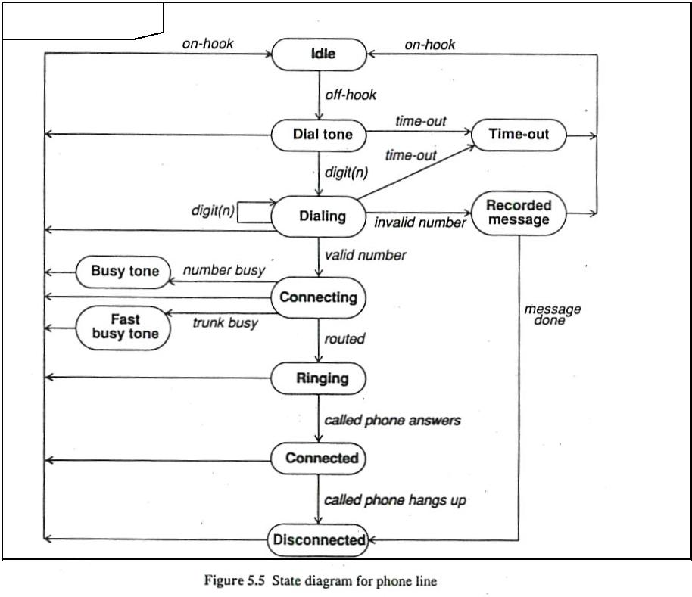
Phone Line
State
Event
Event

Slide 22
State Diagrams (Traffic light example)
Traffic Light
Start
State
Red
Transition
Yellow timer expires
Car trips sensor
Yellow
Green timer expires
Green
Event

Slide 23
ONE SHOT STATE DIAGRAMS
State diagrams can represent continuous loops or one-shot life cycles. Eg: Diagram for the phone line is a continuous loop
One – shot state diagrams represent objects with finite levels and have initial and final states. The initial state is entered on creation of an object ;entry of the final state implies destruction of the object.
Object created in a state and change of the state deletes the object
As an alternate notation, you can indicate initial and final states via entry and exit points. Entry points (hollow circles) and exit points (circles enclosing an "x") appear on the state diagram's perimeter and may be named.

Slide 24
Example
Chess game
start state
White’s
turn
checkmate
black
moves
white
moves
stalemate
stalemate
Black’s
turn
checkmate
Default final state

Slide 25
Example
Chess game
Black
wins
start state
checkmate
White’s
turn
stalemate
Final
states
black
moves
white
moves
Draw
Black’s
turn
stalemate
White
wins
checkmate

Slide 26
Example - entry and exit points
Chess game
checkmate
White’s
turn
Black wins
Draw
White wins
stalemate
black
moves
white
moves
stalemate
Black’s
turn
checkmate

Slide 27
State Diagram : Activity Effects - representing Behavior of object
This references to the behavior of the object with state change or the activity (an action of an activity) that is invoked in response to an event. An activity is the actual behavior that can be invoked by any number of effects. Eg: disconnectPhoneLine might be an activity that is executed in response to an onHook event.
An activity may be performed upon
a transition
the entry to or exit from a state, or
some other event within a state.

Slide 28
Activity Effects
Activity = behavior that can be invoked by any number of effects
May be performed upon:
a transition
entry to or exit from a state
some event within a state
Notation:
event / resulting-activity

Slide 29
Activities
Often useful to specify an activity that is performed within a given state
E.g., while in PaperJam state, the warning light should be flashing
E.g., on entry into the Opening state, the motor should be switched on
E.g., upon exit of the Opening state, the motor should be switched off

Slide 30
Activity effects
Event
Activity
r_button_down / showPopup
Idle
Menu visible
r_button_up / hidePopup

Slide 31
Do-Activities
continue for an extended time
can occur only within a state
can not be attached to a transition
include
continuous operations, such as displaying a picture on a television screen
Sequential operations that terminate by themselves after an interval of time
may be performed for all or part of time that an object is in a state
may be interrupted by event received during execution; event may or may not cause state transition
PaperJam
do/ flash warning light

Slide 32
Entry and Exit Activities
can bind activities to entry to/ exit from a state
All transitions into a state perform the same activity, in which case it is more concise to attach the activity to the state
Opening
entry / motor up
exit / motor off

Slide 33
Order of activities
activities on incoming transition
entry activities
do-activities
exit activities
activities on outgoing transition
Events that cause transitions out of the state can interrupt do-activities. If a do-activity is interrupted, the exit activity is still performed

Slide 34
EXAMPLE
The control of a garage door opener
The user generates depress events with a pushbutton to open and close the door.
Each event reverses the direction of the door.
The control generates motor up and motor down activities for the motor.

Slide 35
FIG: THE CONTROL OF A GARAGE DOOR OPENER
Opening
Depress / motor up
door open / motor off
Depress
/ motor up
Closed
Open
door closed / motor off
Depress/motor down
Closing
Figure: Activities on transitions. An activity may be bound to an event that causes a transition

Slide 36
FIG: THE CONTROL OF A GARAGE DOOR OPENER
Opening
entry / motor up
depress
door open
Closed
entry / motor off
depress
Open
entry / motor off
door closed
depress
Closing
entry / motor down
Figure: Activities on transitions. An activity may also be bound to an event that occurs within a state

